Slide 1


DIGITAL SIGNAL PROCESSING EXTRACTION OF FOETUS HEARTBEAT
J-COMPONENT PROJECT Final Review
RAHUL ANIL NAIR

Slide 2

INTRODUCTION
Every year, one out of hundred babies born with some form of heart defects. This occurs due to genetic syndrome, inherited disorder or environmental factors like misuse of drugs. In any case regular monitoring of heart of the baby is necessary before it is born. Hence, Fetal ECG (FECG) signals are necessary to monitor the heart condition of the baby, so that if any abnormalities found then it can be solved clinically by the concerned doctors.
Fetal ECG monitoring is a widely used technique for diagnosis and to find out fetal abnormalities. The physician can easily prepare himself/herself for the possible abnormalities in a fetus by taking diagnosis of the fetal ECG signal during the pregnancy stage. It’s the simplest non-invasive method to diagnose various heart diseases.

Slide 3

PROBLEM FORMULATION
The main problems involved in the implementation of the project are Separating the Fetal Electrocardiogram(FECG) from Maternal Electrocardiogram(MECG) with minimal noise. Implementing the project in SISO and MISO systems.

Slide 4

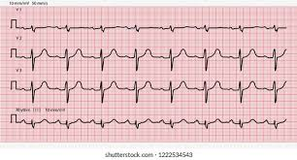
PROPOSED SOLUTION
ADAPTIVE NOISE CANCELLATION SYSTEM
Adaptive noise cancellation is an alternative technique of estimating signals corrupted by additive noise or interference. Its advantage lies in that, with no priori estimates of signal or noise, levels of noise rejection are attained that would be difficult or impossible to achieve by other signal processing methods of removing noise.

Slide 5

ADAPTIVE FILTERS
Adaptive filters are digital filters with an impulse response, or transfer-function, that can be adjusted or changed over time to match desired system characteristics. Unlike fixed filters, which have a fixed impulse response, adaptive filters do not require complete a priori knowledge of the statistics of the signals to be filtered. Adaptive filters require little or no a prior knowledge and moreover, have the capability of adaptively tracking the signal under non-stationary circumstances.

Slide 6
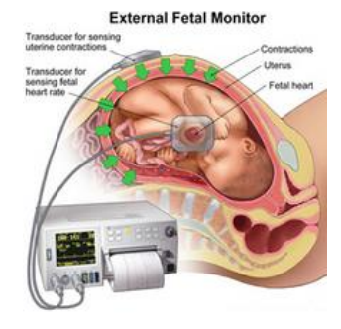
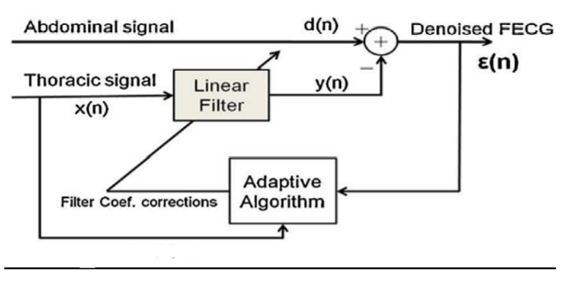
ADAPTIVE ALGORITHMS
An adaptive algorithm is a set of instructions to perform a function that can adapt in the event of changes in environment. Adaptive algorithms are able to intelligently adjust their activities in light of changing circumstances to achieve the best possible output.

Slide 7
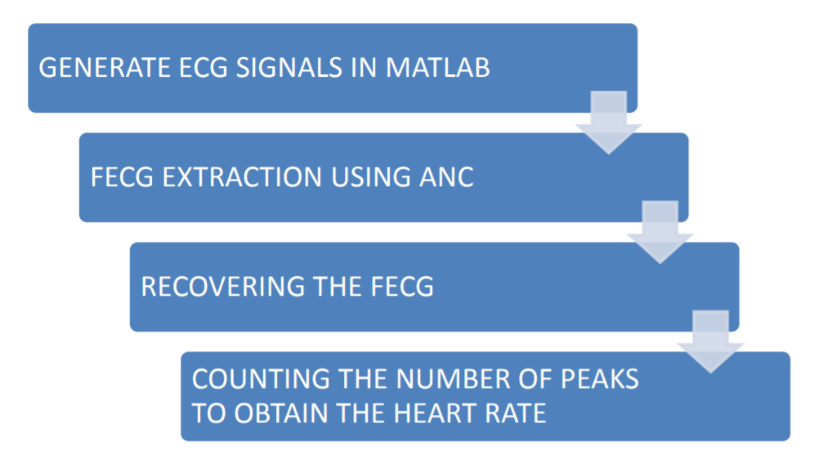
BLOCK DIAGRAM

Slide 8

Types of Adaptive Algorithms used TYPES OF ADAPTIVE ALGORITHMS USED
Least Mean Square Method
Leaky Least Mean Square Method
Normalized Least Mean Square Method

Slide 9
PROJECT IMPLEMENTATION
1. SINGLE INPUT AND SINGLE OUTPUT SYSTEM:
In this SISO implementation, all the thoracic signals are averaged first and then given to the adaptive filter whose tap coefficients are updated using least mean square (LMS), normalized least mean square (NLMS) and leaky least mean square algorithms (LLMS). The average of all the thoracic signals is given as reference input to the adaptive noise canceller (ANC) and the average of all the abdomen signals is given as primary input.
Advantages:
● SISO systems have less complexity
● Designing is simple along with easy implementation.
● Less expensive.
Disadvantages:
● Channel capacity in other techniques is much better than SISO systems.
● Interference and fading occurs.
● Less error correction.

Slide 10
2. MULTIPLE INPUT AND SINGLE OUTPUT SYSTEMS:
MISO or the multiple input and single output system is a scheme of RF wireless communication systems in which there are multiple transmitting antennas at the source and single receiving antennas. Primary signal: The average of abdominal input signals is considered as primary signal.
Advantages:
● To reduce the effects of multipath wave propagation, delay, packet loss etc.
● More antennas are used at the receiving end in MISO systems.
● Error correction increases with increase in number of adaptive filters and hence output will be accurate.
Disadvantages:
● Complexity of the system increases as the number of filter are increased.
● Increase in the number of adaptive filters leads to costly affairs.
● Difficulty in system implementation due to more number of filters.

Slide 11
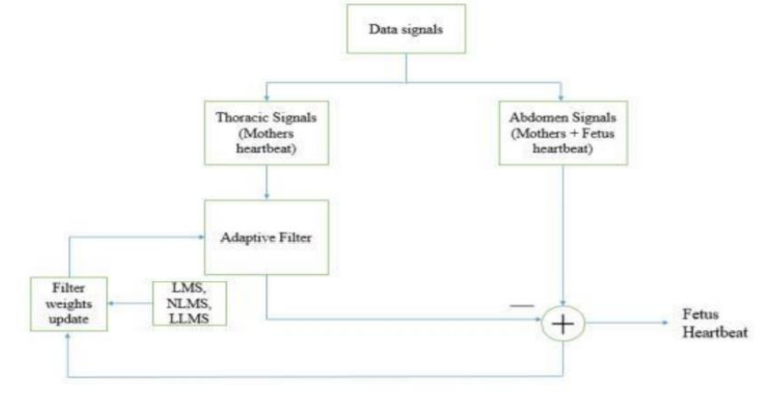
SOURCE CODE IMPLEMENTATION

Slide 12
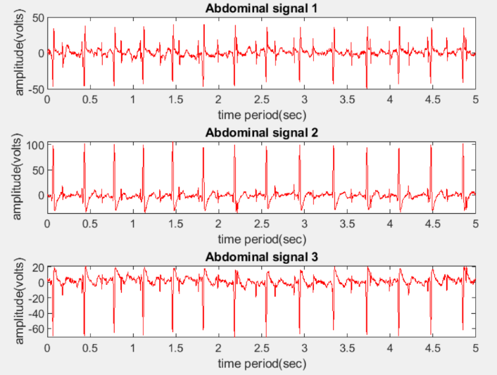
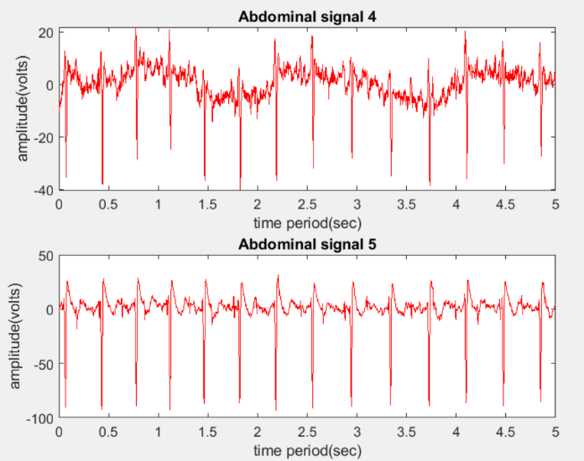
INPUT SIGNALS

Slide 13
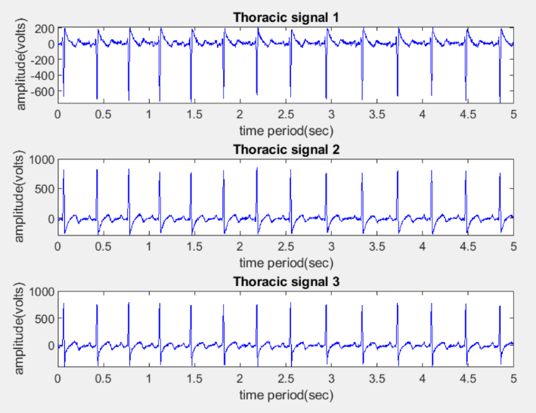
Thoracic Signals

Slide 14
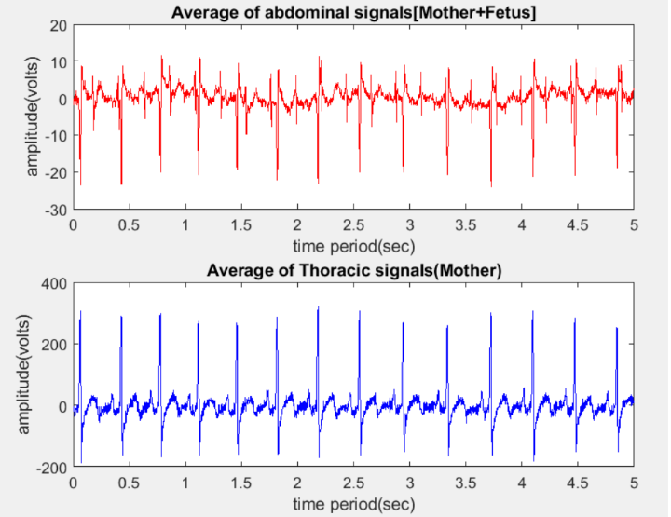
SISO INPUT AND OUTPUT SIGNALS

Slide 15
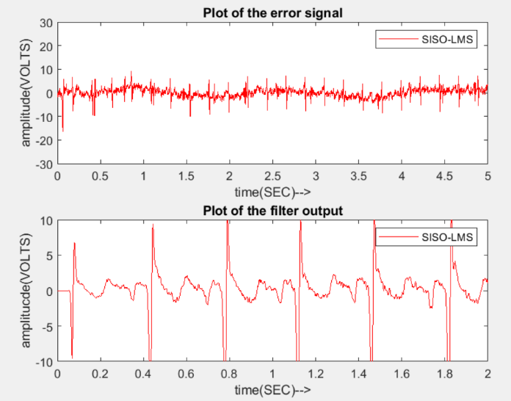
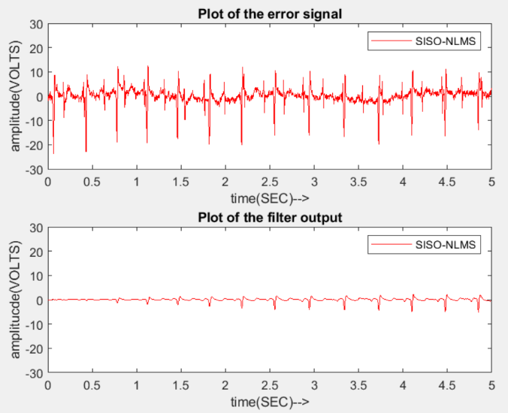
LMS ALGORITHM
NLMS ALGORITHM

Slide 16
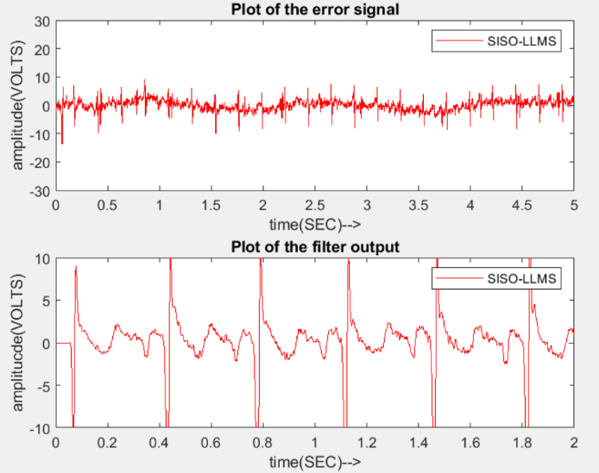
LLMS ALGORITHM

Slide 17
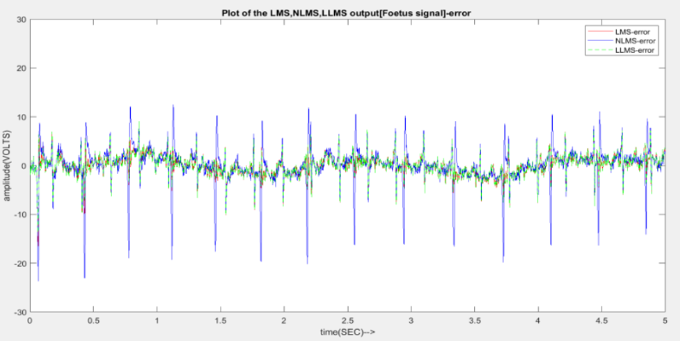
PLOT OF FOETUS SIGNAL-ERROR

Slide 18
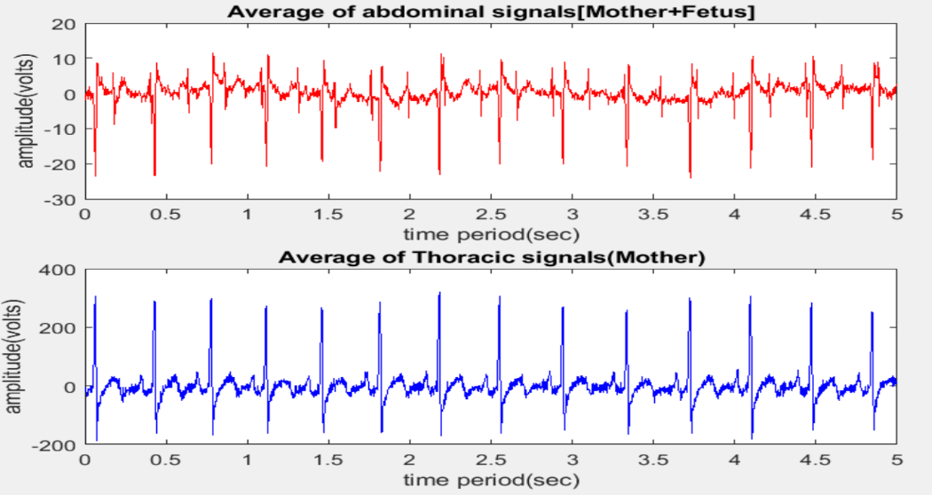
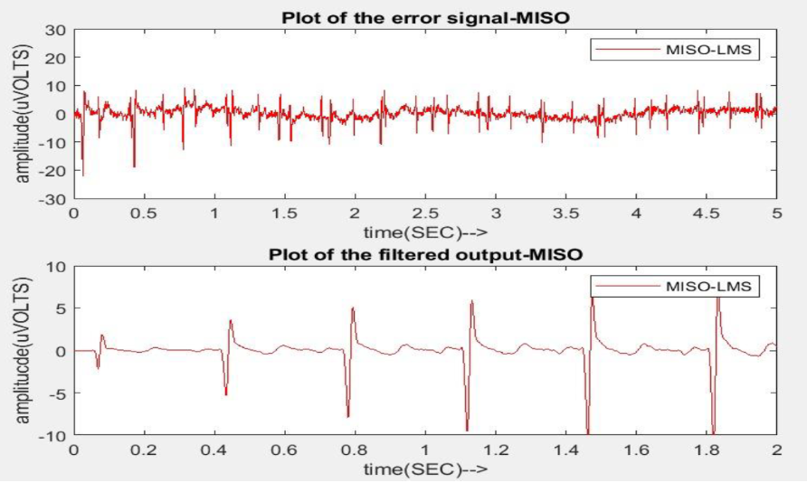
MISO INPUT AND OUTPUT SIGNALS
LMS ALGORITHM

Slide 19
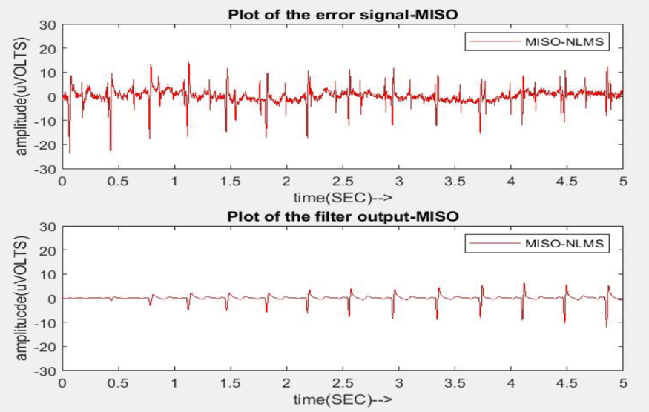
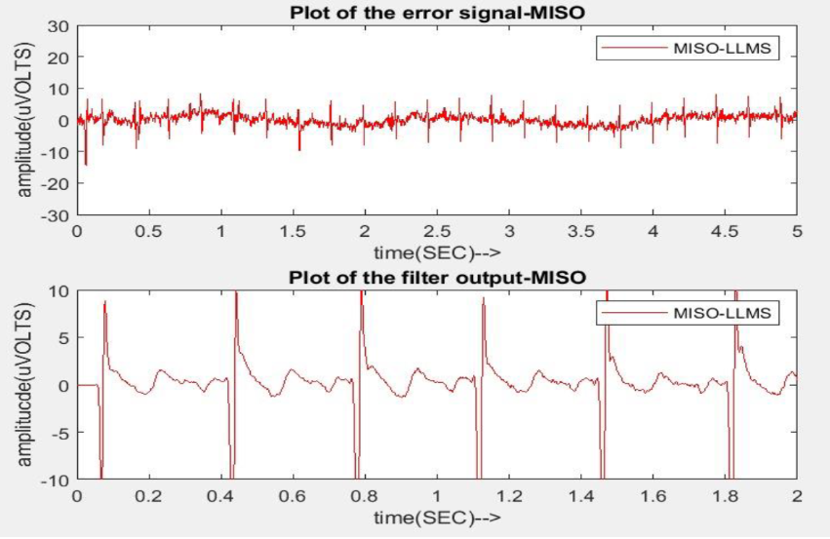
NLMS ALGORITHM
LLMS ALGORITHM

Slide 20
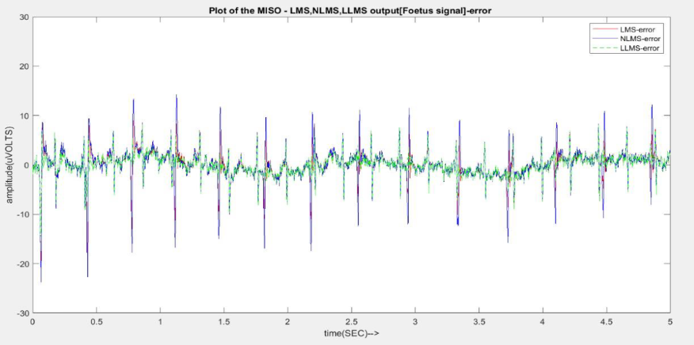
PLOT OF FOETUS SIGNAL

Slide 21
LITERATURE REVIEW
[1] H. H. S. s. Mansoureh Ghodsi, "Extracting fetal heart signal from noisy maternal ECG by multivariate singular spectrum analysis," Statistics and its interface, vol. 3, pp. 399-411, 2010.
In this paper, we propose a multivariate singular spectrum analysis (MSSA) for extracting and separating the mother heart signal, the fetal heart signal and the noise component from the combined ECGs. The proposed method is designed to cope with noisy recordings, which is an important limitation of several approaches proposed in the literature. To validate the proposed algorithm some noisy simulated signals are used. The performance of the technique is also examined using real-life signals.
[2] Yalan Ye, Jing Wan, Zhi-Lin Zhang, Chen Jia, Wu Lei, "A Flexible Fully-Multiplicative Orthogonal-Group BasedICA Algorithm", Computational Intelligence and Bioinformatics and Computational Biology 2007. CIBCB '07. IEEE Symposium on, pp. 476-479, 2007.
Yalan Ye et.al proposed a algorithm that adopted two non-linearities and a flexible non-linear model switching technique to separate mixture of pure subguassian source signals and super-guassian source signals [1].Kavuri Swathi Sri et.al described to evaluate different criterias for generating reference signals which is close to describe signal to exhibit the rhythm in EEG signal [2]. Jiazhi zang et.al developed a cost function to remove noise effects in the signal.

Slide 22
[3] B. P. A. A. B. Prasanth K, "Fetal ECG extraction using adaptive filters," International journal of advanced research in electrical, electronics and instrumentation engineering, vol. 2, no. 4, pp.1483-1487, April 2013.
This paper presents a method for fetal heart rate estimation from an abdominal electrocardiogram (ECG) signal based on adaptive filter analysis using least mean square (LMS) adaptive filtering algorithm in order to determine the health status of a baby in its mother’s womb. The fetal ECG signal is extracted from abdominal ECG containing other sources of interference using the maternal ECG signal obtained from mother’s chest cavity as the reference signal. Interference/noise model used for this work include the power-line noise, the white noise and the unwanted propagating maternal ECG signal. Thereafter, the heart rate is estimated using an automated peak voltage measurement algorithm at 75 percent threshold voltage.
[4] R. Almeida et al., “Fetal QRS detection and heart rate estimation: A wavelet-based approach,” Physiol. Meas., vol. 35, no. 8, pp. 1723–1735, 2014.
Fetal heart rate monitoring is used for pregnancy surveillance in obstetric units all over the world but in spite of recent advances in analysis methods, there are still inherent technical limitations that bound its contribution to the improvement of perinatal indicators. In this work, a previously published wavelet transform based QRS detector, validated over standard electrocardiogram (ECG) databases, is adapted to fetal QRS detection over abdominal fetal ECG. Maternal ECG waves were rst located using the original detector and afterwards a version with parameters adapted for fetal physiology was applied to detect fetal QRS, excluding signal singularities associated with maternal heartbeats.

Slide 23
REFERENCES
[1] D.-l. L. J.-q. Z. Y.-j. Z. Shi-jin Liu, "Extraction of fetal electrocardiogram using recursive least squares and normalized least mean square algorithms," 3rd international conference on advanced computer control, pp. 333- 336, 2011.
[2] Lieven De Lathauwer, Bart De Moor, and Joos Vandewalle, "Fetal electrocardiogram extraction by blind source subspace separation," IEEE TRANSACTIONS ON BIOMEDICAL ENGINEERING, VOL. 47, NO. 5, MAY 2000
[3] B. D. M. J. V. Lieven De Lathauwer, "Fetal electrocardiogram extraction by blind source subspace separation," vol. 47, pp. 567-572, May 2000.
[4] M. H. Hayes, Statistical Digital Signal Processing and Modeling, New york: John Wiley & sons. Inc, 1996.
[5] R. B. &. J. Gawande, "Fetal ECG extraction using wavelet transform," vol. 1, no. 4, pp. 19-22, 2013.

Slide 24
THANK YOU

